Slide 1
Instacart Market Basket Analysis
Annmary K Sebastian - 015215298
Kiran Bala Devineni - 015218866
Sai Nikhil Yandamuri - 015229071

Slide 2
Introduction

Slide 3
Instacart is an American company that operates a grocery delivery and pick-up service. Instacart Market Basket Analysis aims at:
Predicting the next likely product the customer would purchase during the ordering process.
Developing a model which can predict whether a product will be reordered or not.

Slide 4
Dataset Description

Slide 5
The Instacart data has been obtained from Kaggle.
It contains a sample of over 3 million grocery orders from more than 200,000 Instacart users.
For each user, the dataset provides between 4 and 100 of their orders, with the sequence of products purchased in each order.
The dataset also provides the week and hour of day the order was placed, and a relative measure of time between orders.

Slide 6
CSV File | Columns
aisles | aisle_id, aisle
departments | department_id, department
order_products_prior | order_id, product_id, add_to_cart_order, reordered
order_products_train | order_id, product_id, add_to_cart_order, reordered
orders | order_id, user_id, eval_set, order_number, order_dow, order_hour_of_day, days_since_prior_order,
products | product_id, product_name, aisle_id, department_id

Slide 7
Data Visualization

Slide 8
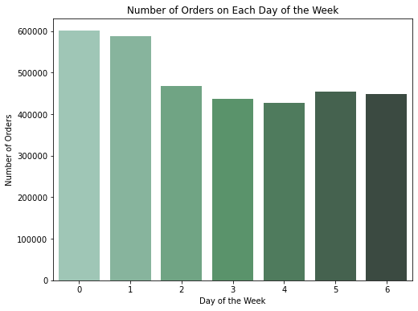
Popular Days
0 → Saturday
1 → Sunday
Least Popular Day
4 → Wednesday

Slide 9
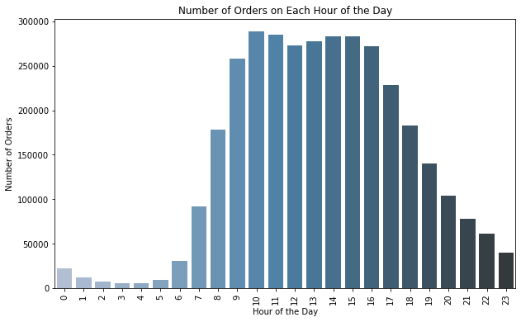
Popular Hours of the Day
10 AM
Least Popular Hours of the Day
3 AM

Slide 10
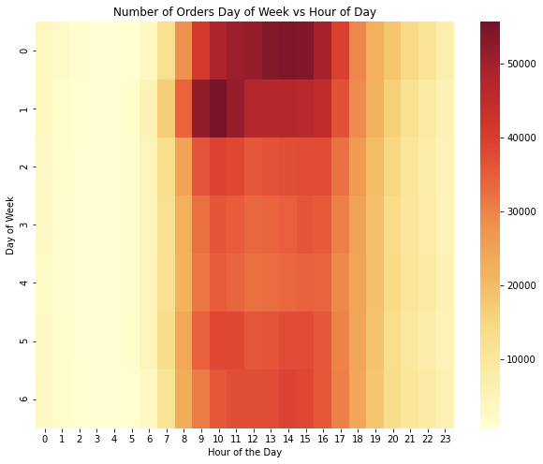
Most Popular Time
Saturday afternoon Sunday morning

Slide 11
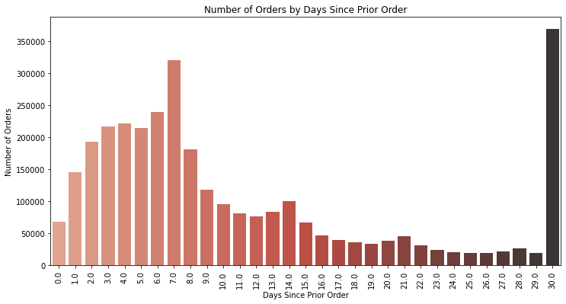
Orders are placed
Monthly
Weekly
Biweekly
Triweekly

Slide 12
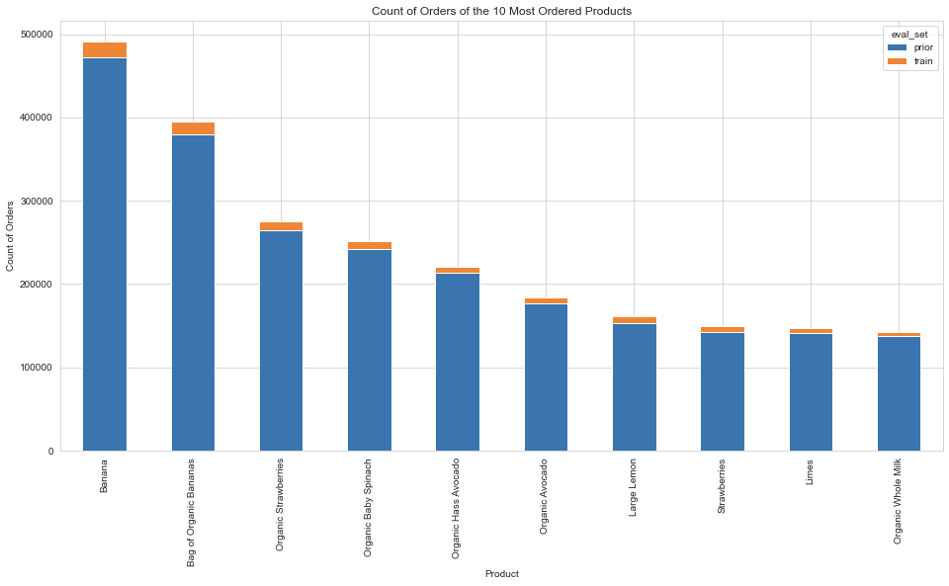
Popular Products
Banana
Bag of Organic Bananas
Organic Strawberry
Organic Baby Spinach
Organic Hass Avocado

Slide 13
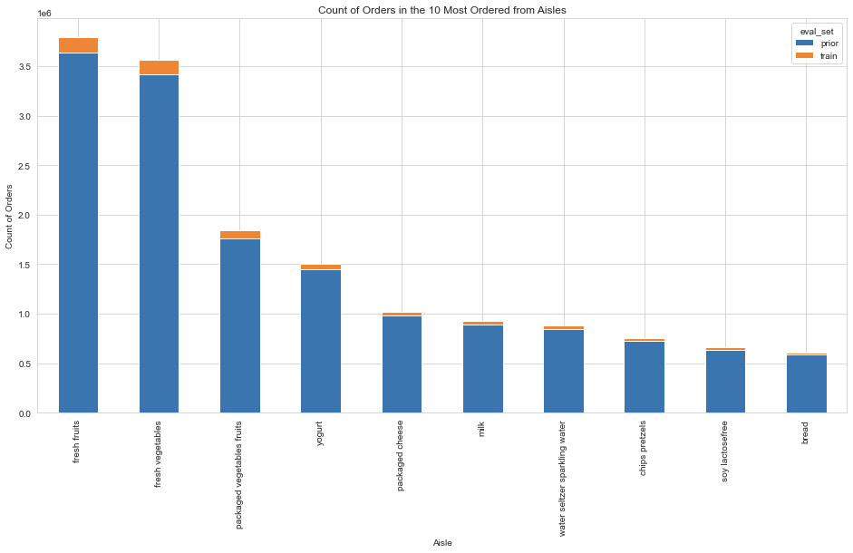
Popular Aisles
Fresh Fruits
Fresh Vegetables
Packaged Vegetables Fruits
Yoghurt
Packaged Cheese

Slide 14
Popular Departments - Produce, Dairy Eggs, Snacks, Beverages, Frozen
Count of Users by Number of Prior Orders ranges between 4 and 100
Number of products added in an order ranges from 1 and 145

Slide 15
Data Modelling

Slide 16
XGBoost
Logistic Regression
Random Forest
Decision Tree
Classification Algorithms
To predict if a product will be reordered or not

Slide 17
ALGORITHM | ACCURACY
XGBoost | 90.47%
Logistic Regression | 90.19%
Random Forest | 90.45%
Decision Tree | 84.40%

Slide 18
Products that are bought together
Apriori algorithm was used for the above.
Frequent item set mining and association rule learning over relational databases.
It identifies the frequent individual items in the database.

Slide 19
Association Rules
Association rules is a rule based machine learning method for discovering interesting relations between variables in large databases.
Association rule generation is usually split up into two separate steps:
A minimum support threshold is applied to find all frequent itemsets in a database.
A minimum confidence constraint is applied to these frequent itemsets in order to form rules.
Notes:
Support is nothing but % of orders that contains item set.
Confidence is percentage that item B is purchased when item A is purchased.

Slide 20
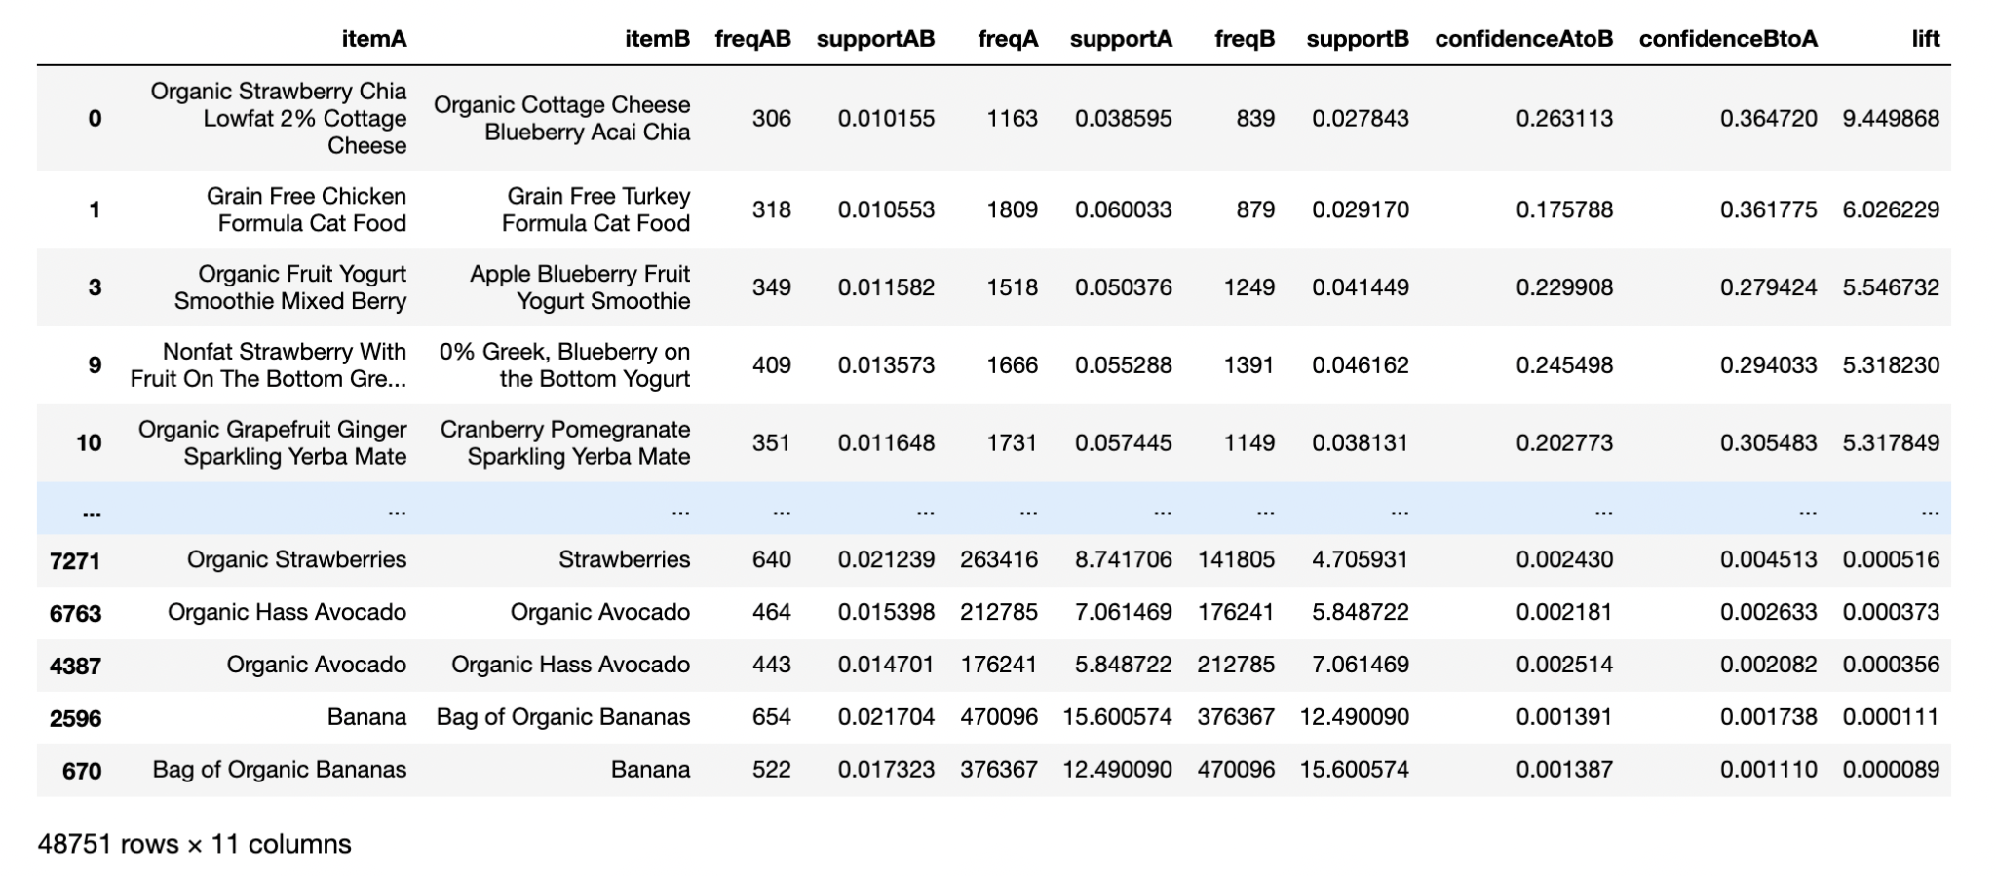

Slide 21
Advantages
Find which products customer will reorder
Find which products are ordered together

Slide 22
THANK YOU

